Slide 1
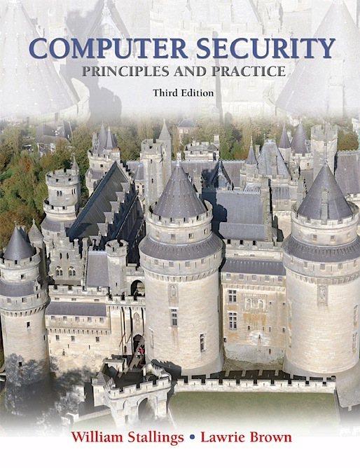
Lecture 2 Cryptography
modified from slides of Lawrie Brown
Notes:
In most computer security contexts, user authentication is the fundamental building
block and the primary line of defense. User authentication is the basis for most
types of access control and for user accountability.

Slide 2
Cryptography
The main objective of cryptography is to Ensure security of communication over insecure medium
Privacy (secrecy, confidentiality)
Integrity
Communicate even with possibility of adversaries
Notes:
RFC 2828 defines user authentication as follows:
The process of verifying an identity claimed by or for a system entity.

Slide 3
Hash Functions

Slide 4
Hash Functions

Slide 5
Hash Functions

Slide 6
Hash Functions

Slide 7
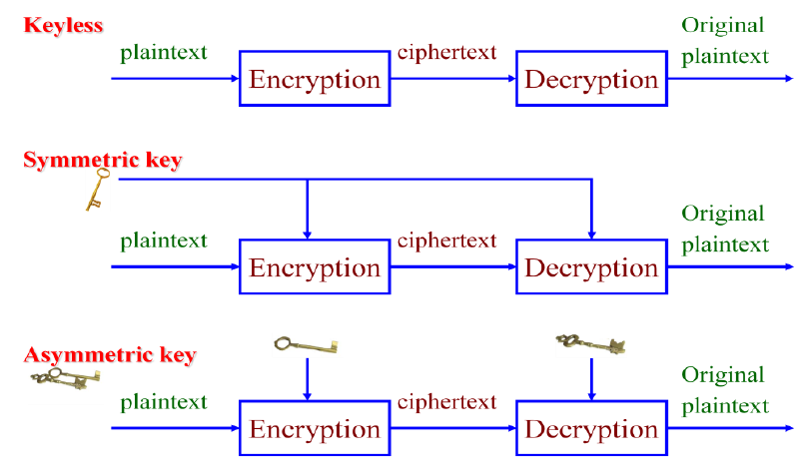
Types of Cryptography

Slide 8
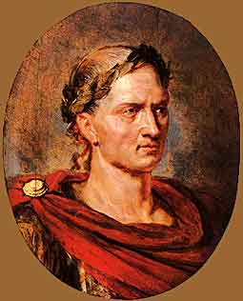
Caesar Cipher (Symmetric)
One of the earliest known uses of cryptography was by Julius Caesar. He made messages secret by shifting each letter three letters forward in the alphabet (sending the last three letters of the alphabet to the first three). For instance, using this scheme the letter B is sent to E and the letter X is sent to A.

Slide 9
Caesar Cipher (Symmetric)
In the encrypted version of the message, the letter represented by p is replaced with the letter
represented by
(p + 3) mod 26.

Slide 10
Caesar Cipher (Symmetric)

Slide 11
Caesar Cipher (Symmetric)

Slide 12
Cryptanalysis of Caesar Cipher
There are three ways of breaking Caeser Cipher code
Letter Frequency analysis
Brute force analysis
Tracing single spaced letters such as “I” or “a” or double letter words such as “an”, “if”, “is” etc.

Slide 13
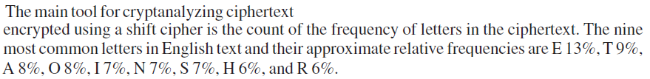
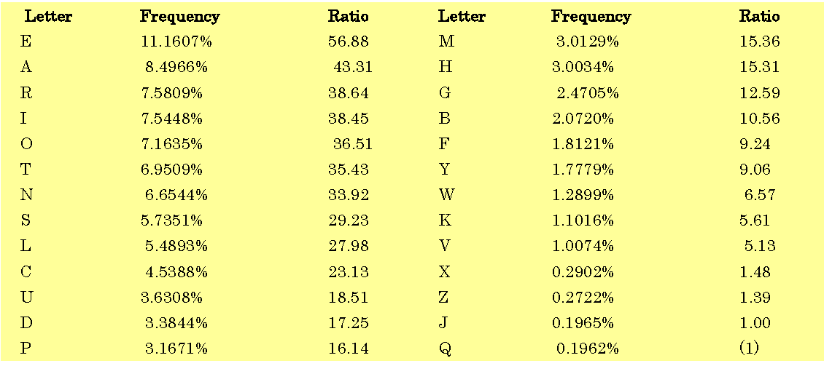
1. Letter frequency Analysis

Slide 14
1. Letter frequency Analysis

Slide 15
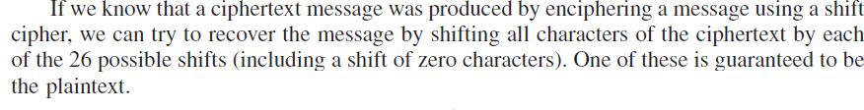
2. Brute force analysis

Slide 16
3. Specific letters analysis
Clues
Short words,
Words with repeated patterns,
Common initial and final letters, …
Knowledge of language may simplify it

Slide 17

Exercise
wklv phvvdjh lv qrw wrr kdug wr euhdn

Slide 18
Block Ciphers (Symmetric avoids Letter Frequency Analysis)

Slide 19
Block Ciphers

Slide 20
RSA Algorithm (Asymmetric)

Slide 21
RSA Algorithm
مثال لتوضيح فكرة RSA بشكل مبسط
قم بتكوين مفتاحين مفتاح اول ( عام (n)+ مفتاح عام محلي(e)) والمفتاح الثاني ( عام (n) + مفتاح خاص محلي (d) )
ارسل الصندوق الى المستقبل فارغا ومعه (المفتاح الاول)،
المفتاحين العامين) المجمعان في المفتاح الأول) يغلقان الصندوق فقط ولا يمكن استخدامهما في فتح الصندوق
يقوم المستقبل بوضع المعلومات السرية في الصندوق ثم يستخدم المفتاحين العامين في غلق الصندوق ، لاحظ ان الصندوق لا يمكن فتحه حتى المستقبل لن يستطيع فتحه مرة أخرى
يعيد الصندوق الى المرسل ومن ثم يقوم المرسل بفتح الصندوق بدمج مفتاحه الخاص مع المفتاح العام (المفتاح الثاني)، (المفتاح الخاص يفتح الصندوق فقط ولا يغلقه)

Slide 22
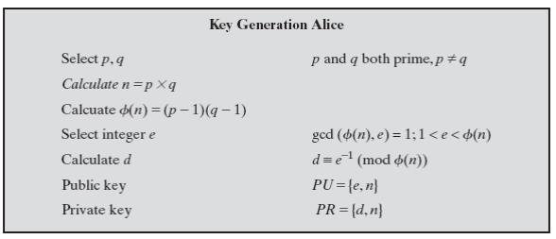
RSA Algorithm

Slide 23
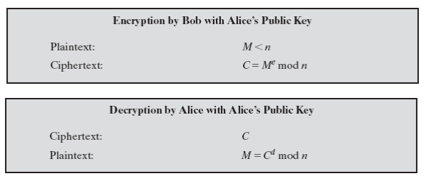
RSA Algorithm

Slide 24
RSA Algorithm
Generating Public and Private Keys First, as we mentioned above, before any transmission happens, the Server had calculated its public and secret keys. Here is how.
1.1) pick two prime numbers, we'll pick p = 3 and q = 11
1.2) calculate n = p * q = 3 * 11 = 33
1.3) calculate ɸ (n) = ( p - 1 ) * ( q - 1 ) = ( 3 - 1 ) * ( 11 - 1 ) = 20
1.4) choose a prime number e, such that e is co-prime to ɸ (n), i.e, ɸ (n) is not divisible by e. We have several choices for e: 7, 11, 13, 17, 19 (we cannot use 5, because 20 is divisible by

Slide 25
RSA Algorithm
Generating Public and Private Keys
5). Let's pick e=7 (smaller e, "less math"). 1.5) So, the numbers n = 33 and e = 7 become the Server's public key. 1.6) Now, still done in advance of any transmission, the Server has to calculate it's secret key. Here is how. 1.7) e * d= 1 ( mod ɸ (n) ) 1.8) 7 * d = 1 ( mod 20 ) 1.9) ( 7 * d ) / 20 = ? with the remainder of 1 (the "?" here means: "something, but don't wory about it"; we are only interested in the remainder). Since we selected (on purpose) to work with small numbers, we can easily conclude that 21 / 20 gives "something" with the remainder of 1. So, 7 * d = 21, and d = 3. This is our secret key. We MUST NOT give this key away.

Slide 26
RSA Algorithm
Constructing Encryption/Decryption Keys:
The public key (7,33) and the Private key (3,33) can be used to Encrypt/Decrypt text. The following two rules are used
(Encrypted Text) C=M⁷ mod 33
(Clear Text) M=C³ mod 33
The following list of litters can be used for training only (real RSA works with different scheme)
a b c d e f g h I j k l m n o p q r s t u v w x y z ! @ # $ % & * (they are 33 letters)

Slide 27
RSA Algorithm
Example 1: Encrypt the sentence “I love you” don’t consider upper/lower cases. Use RSA with public key (7, 33)
Solution:
I love you has the following position sequence (09 12 15 22 05 25 15 21).
09⁷ mod 33 = 15
12⁷ mod 33 = 12
15⁷ mod 33 = 27
22⁷ mod 33 = 22
05⁷ mod 33 = 14
25⁷ mod 33 = 31
15⁷ mod 33 = 27
21⁷ mod 33 = 21
The resulting sequence is (15 12 27 22 14 31 27 21) which corresponds to (o l!vn %!u)

Slide 28
RSA Algorithm
Example 2: Decrypt the sentence “o l!vn %!u” don’t consider upper/lower cases. Use RSA with private key (3, 33)
Solution:
(o l!vn %!u) has the following position sequence (15 12 27 22 14 31 27 21).
15³ mod 33 = 09
12³ mod 33 = 12
27³ mod 33 = 15
22³ mod 33 = 22
14³ mod 33 = 05
31³ mod 33 = 25
27³ mod 33 = 15
21³ mod 33 = 21
The resulting sequence is (09 12 15 22 05 25 15 21) which corresponds to (I love you)

Slide 29
Homework
1.1 Consider the following encrypted text
JLQEBO: TEXQ AFA VLR IBXOK FK PZELLI QLAXV PLK: ELT QL TOFQB JLQEBO: TEXQ AFA VLR TOFQB? PLK: F ALK'Q HKLT, QEBV EXSBK'Q QXRDEQ RP ELT QL OBXA VBQ!
Use your own experience to decrypt the text
Decrypt it using the tool available at http://www.simonsingh.net/The_Black_Chamber/caesar.html. What is the plain text? What is the key?
1.2 Use Caesar cipher to decrypt the following text if you know that the encryption key is: Ci = pi + 4 mod 26 and alphabets used are ABCDEFGHIJKLMNOPQRSTUVWXYZ
QMWWMSR MQTSWWMFPI
Reference: The RSA Algorithm explained Using Simple Pencil and Paper Method.

